Slide 1
Returning to France after a study abroad experience
February 5, 2026

Slide 2

RETURNING TO FRANCE AFTER STUDY ABROAD
Campus France USA
A French governmental agency based at the Embassy of France in Washington, D.C.
Find out more about us:
Campus France USA promotes French higher education in the United States, advises students wishing to pursue study in France, and is responsible for the pre-consular application review process necessary for all student visa applicants.
https://www.campusfrance.org/en/Campus-France-missions
https://www.usa.campusfrance.org/campus-france-usa
https://www.usa.campusfrance.org/contact

Slide 3
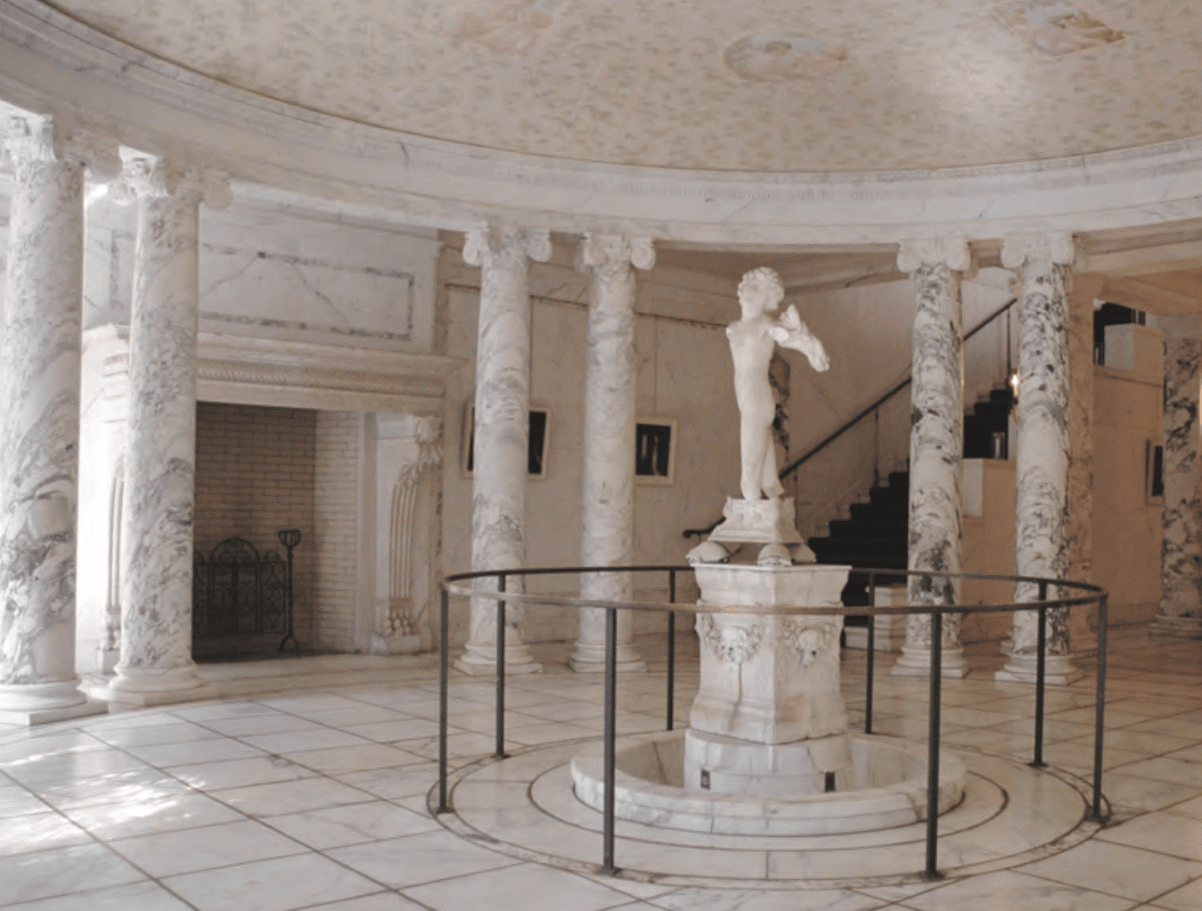

RETURNING TO FRANCE AFTER STUDY ABROAD
Villa Albertine
The French Institute
for Culture and Education
Villa Albertine crafts projects and programs aimed at making French language and culture accessible to US audiences and builds partnerships between French and American higher education institutions. There are VA offices in ten cities across the country (Atlanta, Boston, Chicago, Houston, Los Angeles, Miami, New Orleans, New York, San Francisco, & Washington, DC).
Villa Albertine is the cultural service of the French Embassy in the United States but it is headquartered in New York City.
Campus France is a part of Villa Albertine.

Slide 4
RETURNING TO FRANCE AFTER STUDY ABROAD
A master’s program
01
Options for returning students
Apply directly to programs through the Etudes en France platform
FLE programs
02
Learn about programs with the Qualite FLE label that assures quality
Other courses of study
03
Explore short programs and programs in the arts.
TAPIF
04
Get paid to teach English in France

Slide 5
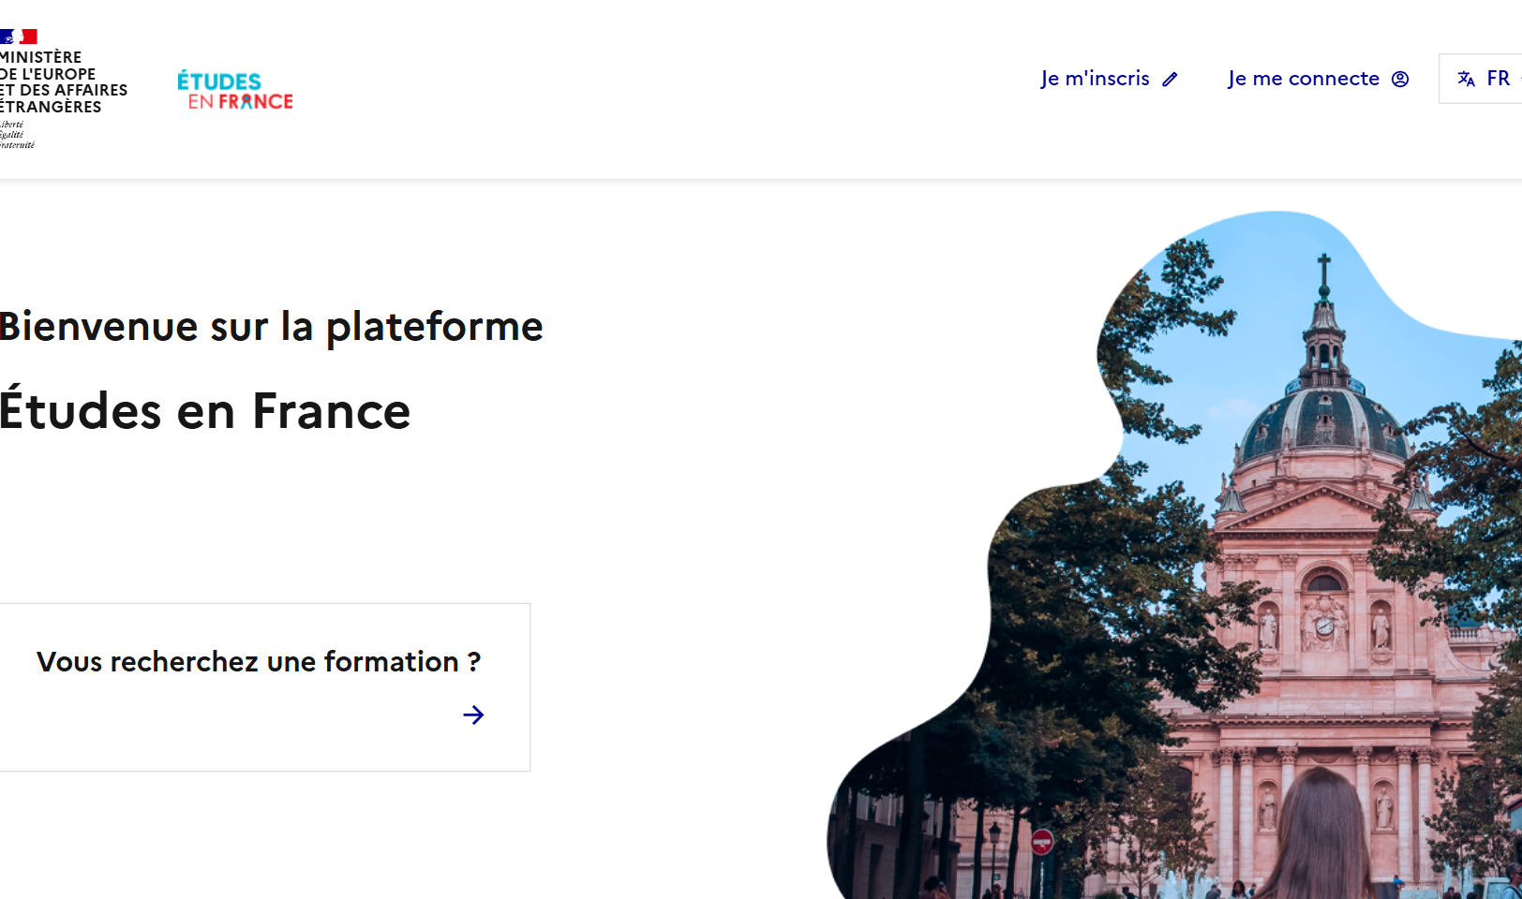
RETURNING TO FRANCE AFTER STUDY ABROAD
Etudes en France
The common application for master’s programs in France
Students can apply to up to 7 master’s-level programs at a time through the Etudes en France platform.
https://www.usa.campusfrance.org/applying-to-a-french-institution
https://www.usa.campusfrance.org/etudes-en-france-guideline

Slide 6
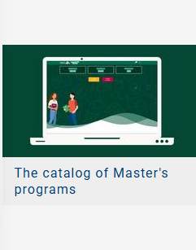

RETURNING TO FRANCE AFTER STUDY ABROAD
Resources for finding a program
CF Master’s Degrees Catalog
CF Taught in English Catalog
https://cataloguelm.campusfrance.org/master/#/catalog?lang=en
https://taughtie.campusfrance.org/tiesearch/#/catalog

Slide 7

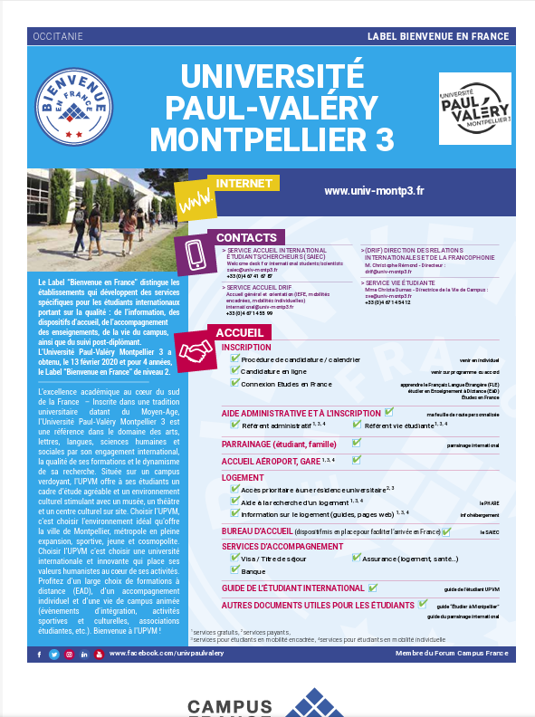
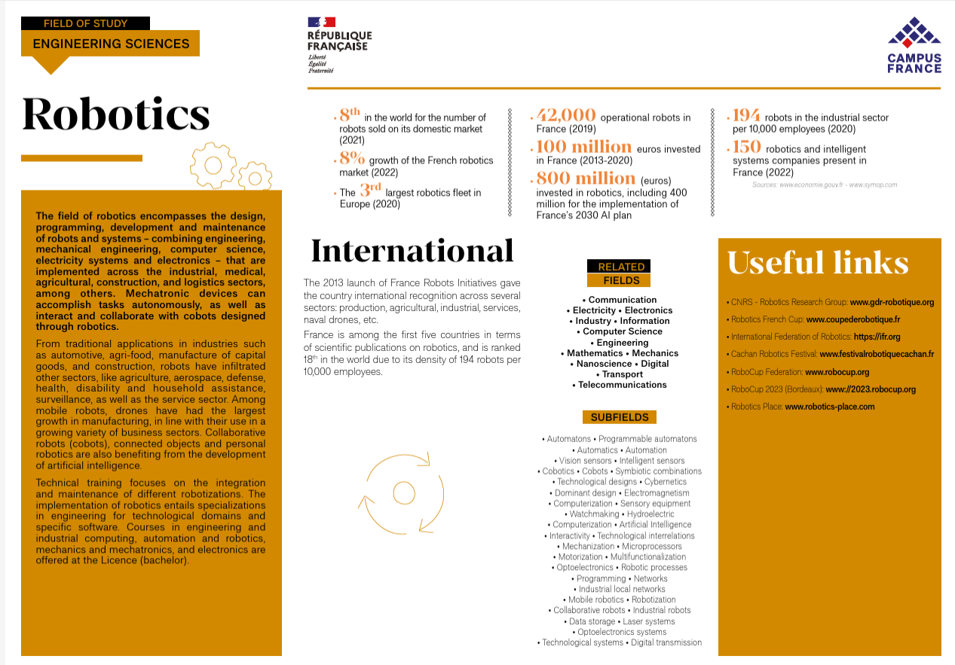
RETURNING TO FRANCE AFTER A STUDY ABROAD PROGRAM
Resources on the Campus France website
Information on specific courses of study, popular cities for students, individual institutions, etc.
https://www.campusfrance.org/fr/espace-documentaire

Slide 8
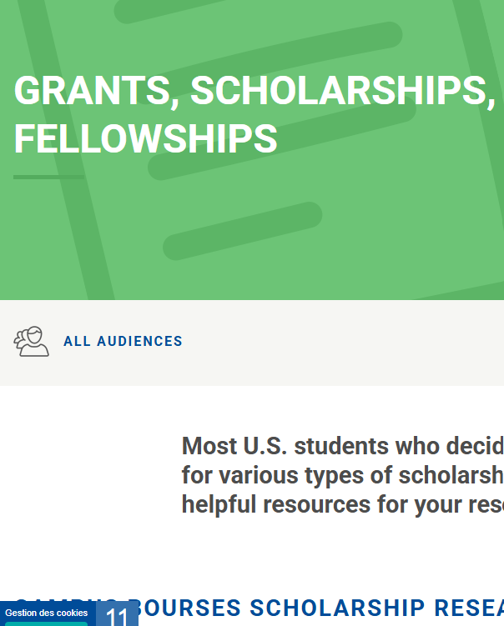
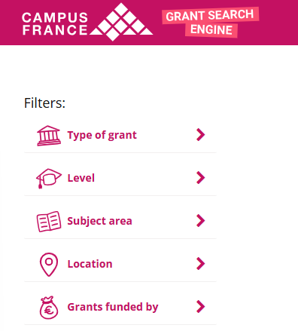
RETURNING TO FRANCE AFTER STUDY ABROAD
Resources for funding
CF USA Grants, Scholarships, and Fellowships page
CF Campus Bourses Grant Search Engine
https://www.usa.campusfrance.org/grants-scholarships-and-fellowships
https://campusbourses.campusfrance.org/#/catalog

Slide 9
RETURNING TO FRANCE AFTER STUDY ABROAD
Where to find more information
Lafayette Fellowship
Lafayette website
https://lafayette.villa-albertine.org/
Applicants must be 27 years old or younger as of July 1, 2026 and in possession of a bachelor’s degree from a U.S. institution (completed between January 2023 and June 2026) with a GPA of no less than 3.7 on a 4.0 scale. Knowledge of French is not required for acceptance into the Lafayette program.
Guidelines for Applicants
https://lafayette.villa-albertine.org/wp-content/uploads/2025/09/Lafayette-Fellowship-Guidelines-For-Applicants.pdf
Lafayette FAQ
https://lafayette.villa-albertine.org/faq/

Slide 10


RETURNING TO FRANCE AFTER STUDY ABROAD
FLE programs
Study French in France
The Qualite FLE label helps students identify centers with high quality instruction.
Learn French in a university setting in preparation for higher education.
https://www.qualitefle.fr/en
https://adcuefe.com/

Slide 11


RETURNING TO FRANCE AFTER STUDY ABROAD
Other courses of study
Campus France Summer School and Short Programs Catalog
Promotion of FrenchHigher Education in Art, Design, Fashion, Music, 3D, and Architecture
https://ecolesdete.campusfrance.org/#/main
https://www.campusart.org/?lang=en

Slide 12

RETURNING TO FRANCE AFTER STUDY ABROAD
TAPIF
The Teaching Assistant Program in France
US Citizens or permanent residents between the ages of 20 and 35 who have completed at least three years of university-level education, are native speakers of English, and have at least a B1 level of French can apply to teach English in French public schools.
TAPIF participants work 12 hours a week in up to 3 schools for from October through April.
https://villa-albertine.org/frenchculture/frenchcultures/teach-english-in-france/

Slide 13

Kathryn Manz
Deputy Director of Campus France USA
kathryn.manz@villa-albertine.org

